Slide 1

DEPARTMENT OF MECHANICAL ENGINEERING INDIAN INSTITUTE OF TECHNOLOGY ROPAR
RUPNAGAR-140001, INDIA
IIT Ropar
MID SEMESTER EVALUATION
DESIGN OF AUTOMATIC DOOR MECHANISM
HARSH ALOK SHAH (2023MEB1344)
AYUSH KUMAR SAW (2023MEB1331)
SHRESHTH SHUKLA (2023MEB1379)
ADITYA SHARMA (2023MEB1325)
Lab Group No: TU_C

Slide 2
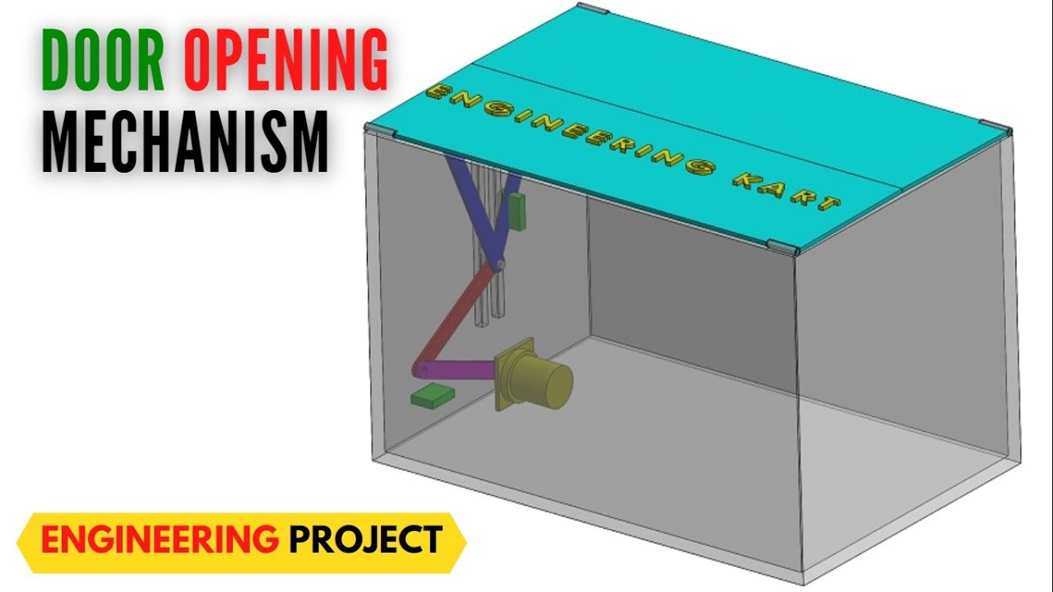
DOUBLE DOOR MECHENISM
A double door mechanism involves two adjacent doors that open from the center, typically using hinges or sliding tracks. Common in entrances and cabinets, it offers wider access and enhanced aesthetics. Some versions include synchronized opening, where one door’s movement activates the other, improving convenience and smooth operation.
APPLICATION:
Double door mechanisms are widely used in residential, commercial, and industrial settings. In homes, they are popular for main entrances, enhancing aesthetics and access. Commercially, they’re common in malls, hospitals, and offices for smooth crowd flow. Industrial applications include warehouses and cold storage units, allowing large equipment or goods to pass through easily. They are also used in elevators, cabinets, and vehicles, offering functionality, space efficiency, and improved accessibility.

Slide 3
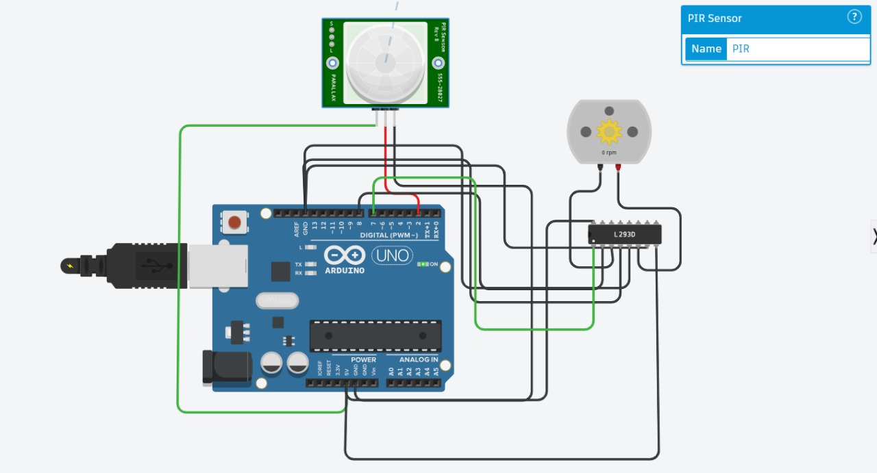
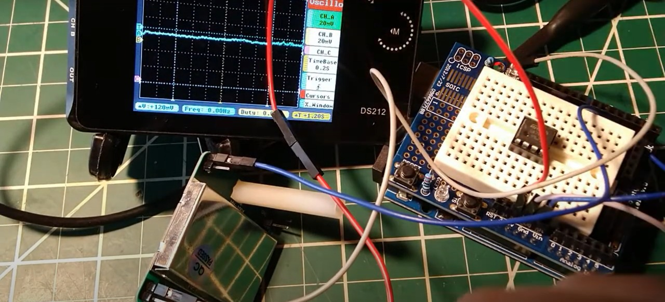
CIRCUIT DIAGRAM
The LM358 op-amp is used with Doppler sensors for signal amplification, waveform shaping, and noise filtering. It boosts weak analog signals to a readable level for microcontrollers. Acting as a comparator, it converts noisy sine waves into clean digital pulses. In a setup with Arduino, PIR sensor, L293D motor driver, and DC motor, motion detection triggers the motor. An oscilloscope confirms proper signal spikes. The LM358 ensures accurate, reliable motion detection by refining and amplifying sensor outputs.

Slide 4
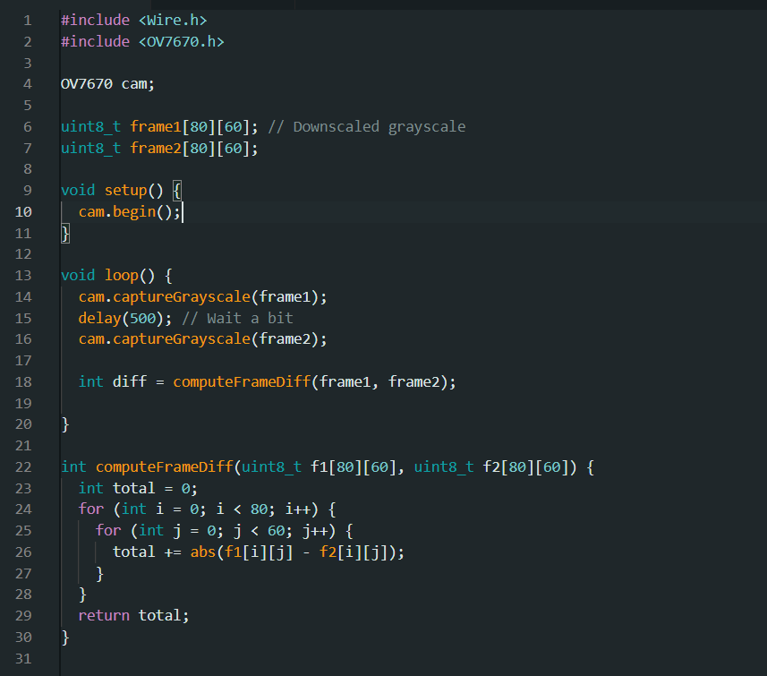
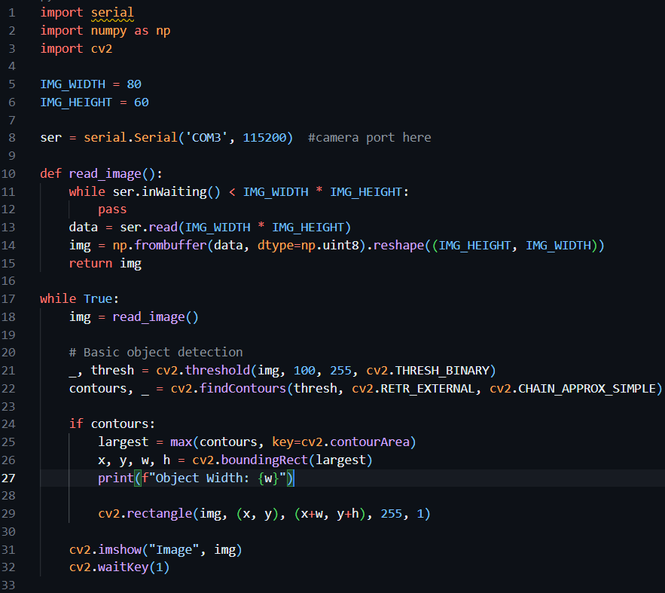
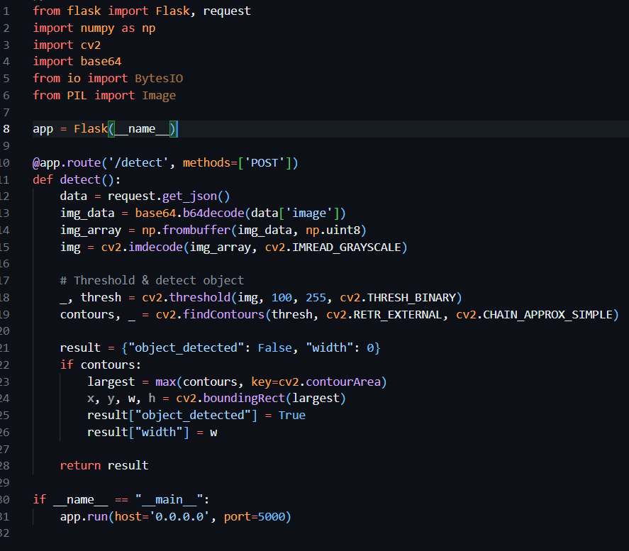
COMPUTER VISION CODING
Our object detection system works in two phases. In Phase 1, images from the ESP32 + OV7670 are sent to a PC via serial, where a Python script processes and trains a model to detect object type and size. In Phase 2, the trained model is deployed on a server. The ESP32 sends images over Wi-Fi using HTTP POST with base64 encoding. The server detects objects and responds; based on this, the ESP32 rotates a servo to open doors.

Slide 5
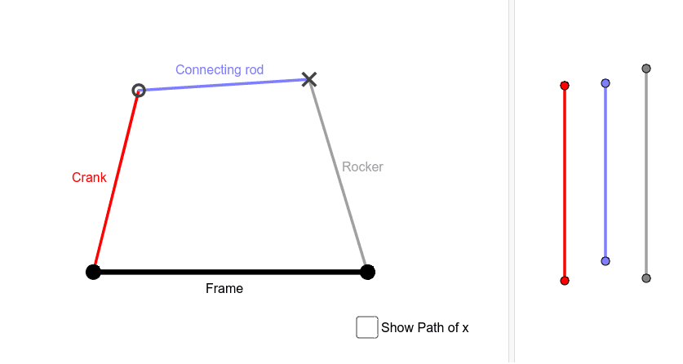
FOUR BAR MECHENISM
A four-bar mechanism is a simple movable linkage consisting of four rigid bars connected by pivots to form a closed loop. It includes a fixed frame, input link (driver), coupler link, and output link (follower). This mechanism converts rotational motion into a variety of complex motions like oscillating, reciprocating, or rotating. Widely used in engines, robotic arms, and suspension systems, it provides controlled and repeatable motion. Its versatility and simplicity make it essential in mechanical and automotive engineering applications.

Slide 6
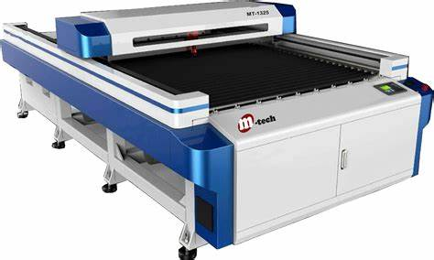
LASER CUTTING
Laser cutting is a precise and efficient manufacturing process that uses a high-powered laser beam to cut materials like metal, wood, plastic, or fabric. It offers high accuracy, clean edges, and minimal waste. Commonly used in industrial manufacturing, design, and prototyping, laser cutting is ideal for intricate patterns and detailed work across various materials.
We performed laser cutting on wood sheets of sizes 50 × 30 cm and 30 × 30 cm to fabricate components for a wooden box designed to house a double-door mechanism.

